Slide 1
Lab 01 Android Studio Installation + Starting of Android Program
By
Israr Ahmad

Slide 2
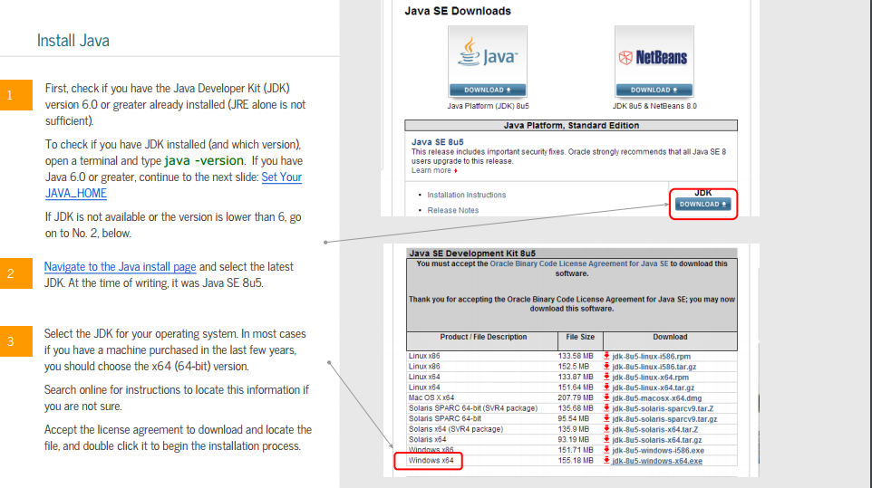
Copy the below Links and Just click
http://www.oracle.com/technetwork/java/javase/downloads/jdk8-downloads-2133151.html

Slide 3
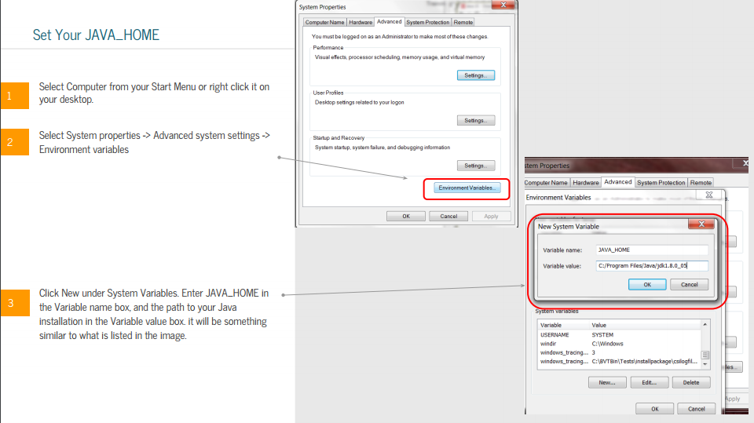
Step 2: Right Click on My Computer and then Property -> Advance system setting

Slide 4
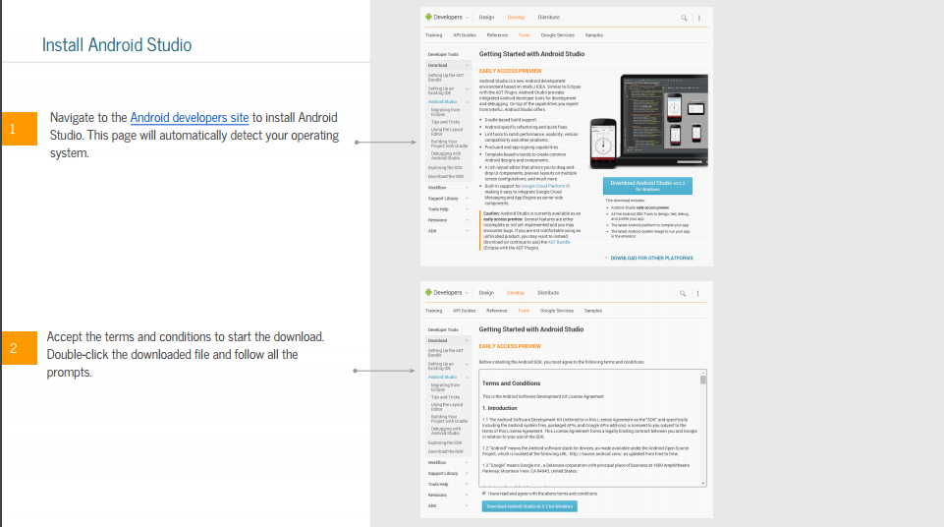
Go to Google and paste the below Url
https://developer.android.com/studio/index.html?gclid=CP6RqPq5gNICFSIL0wodwt4FxA

Slide 5
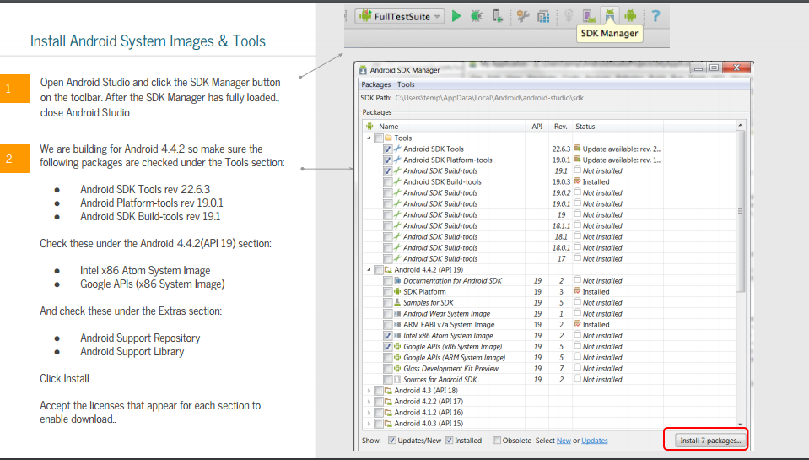
Click on SDK Manager then follow the image below

Slide 6
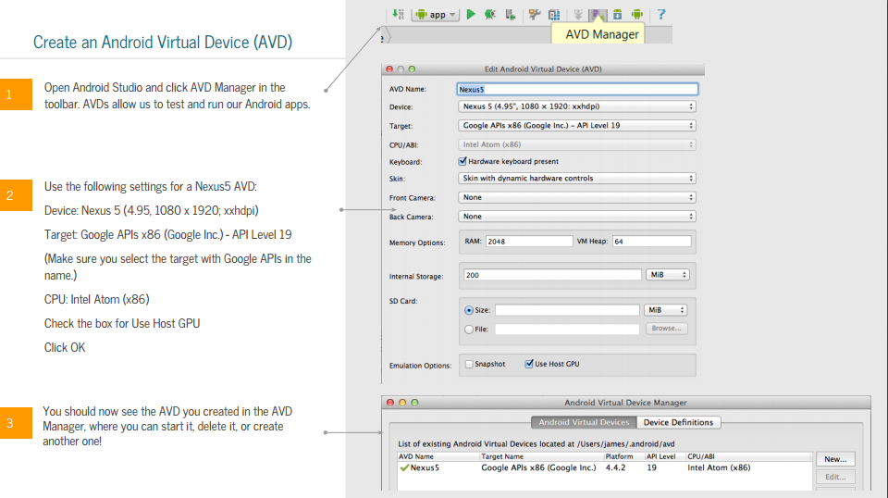
Click on AVD Manager

Slide 7
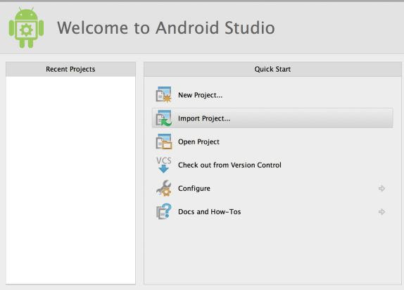
Getting Started
After Successful installation You should see this:

Slide 8
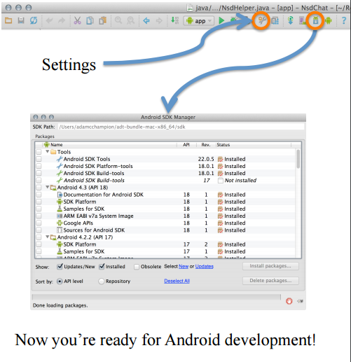
Strongly recommend testing with real Android device – Android emulator: very slow – Faster emulator: Genymotion

Slide 9
Android Highlights
Android apps written in Java 5
– Actually, a Java dialect (Apache Harmony)
– Everything we’ve learned still holds
• Apps use four main components:
– Activity: A “single screen” that’s visible to user
– Service: Long-running background “part” of app (not separate process or thread)
– ContentProvider: Manages app data (usually stored in database) and data access for queries
– BroadcastReceiver: Component that listens for particular Android system “events”, e.g., “found wireless device”, and responds accordingly

Slide 10
App Manifest
Every Android app must include an AndroidManifest.xml file describing functionality
The manifest specifies:
App’s Activities, Services, etc.
Permissions requested by app
Minimum API required
Hardware features required, e.g., camera with autofocus
External libraries to which app is linked, e.g., Google Maps library

Slide 11
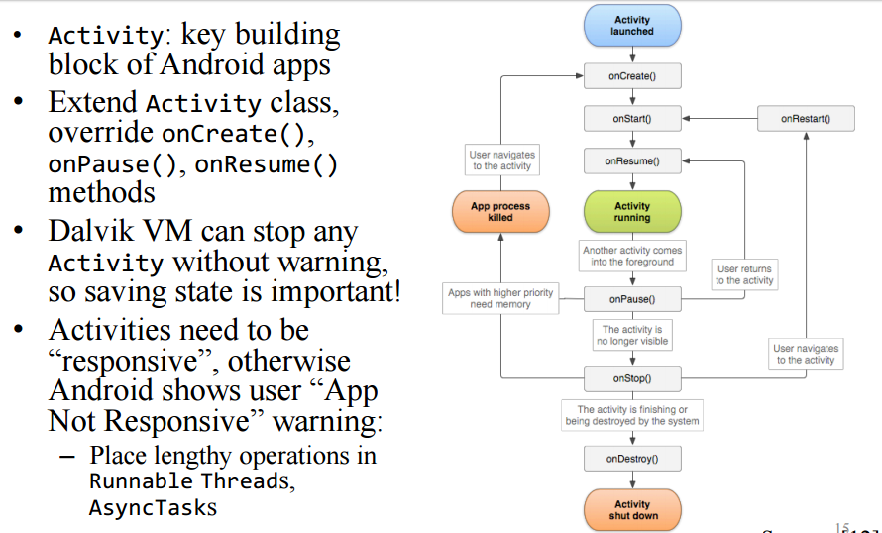
Activity Lifecycle

Slide 12
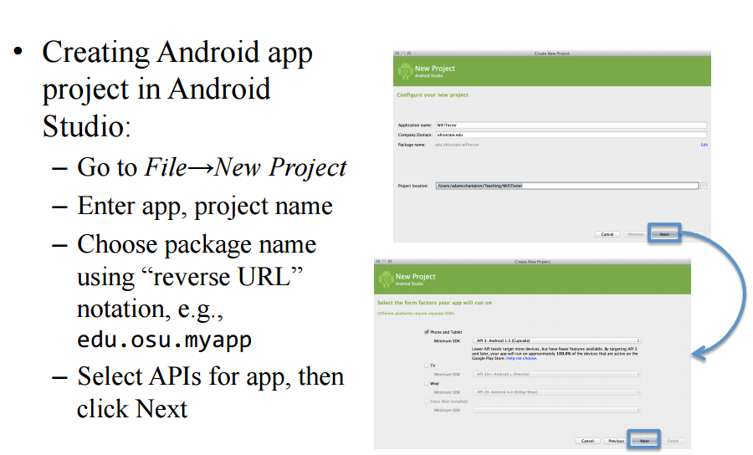
Creating Android App

Slide 13
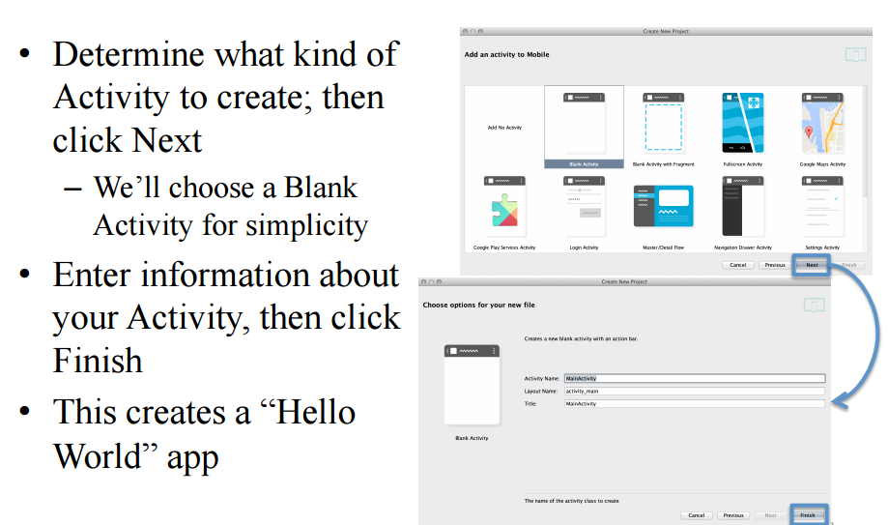
Creating Android App Continuee…

Slide 14
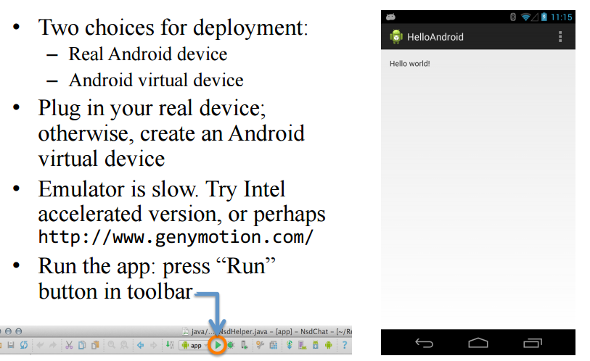
Deploying the App

Slide 15
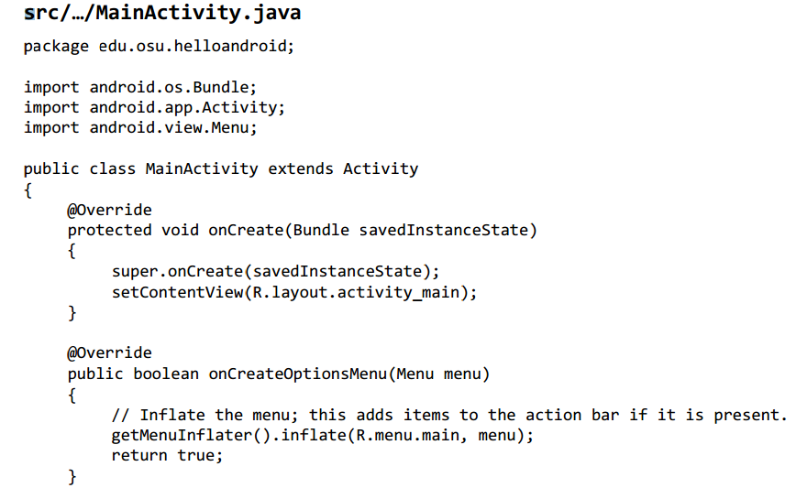
Underlying Source Code

Slide 16
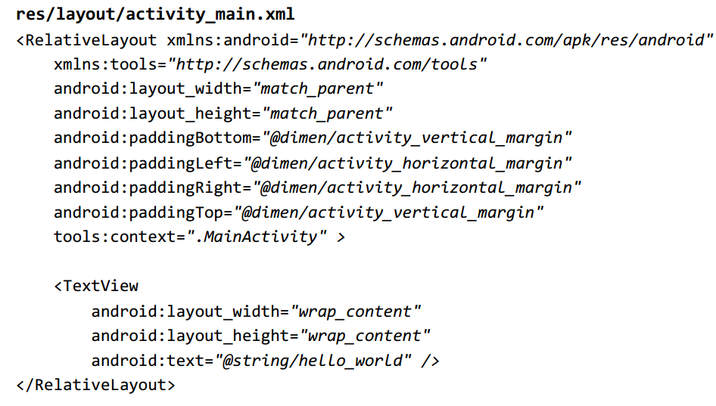
Underlying GUI Code

Slide 17
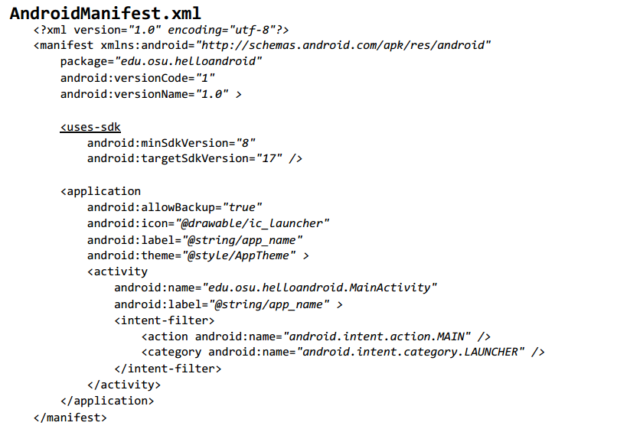
The App Manifest

Slide 18
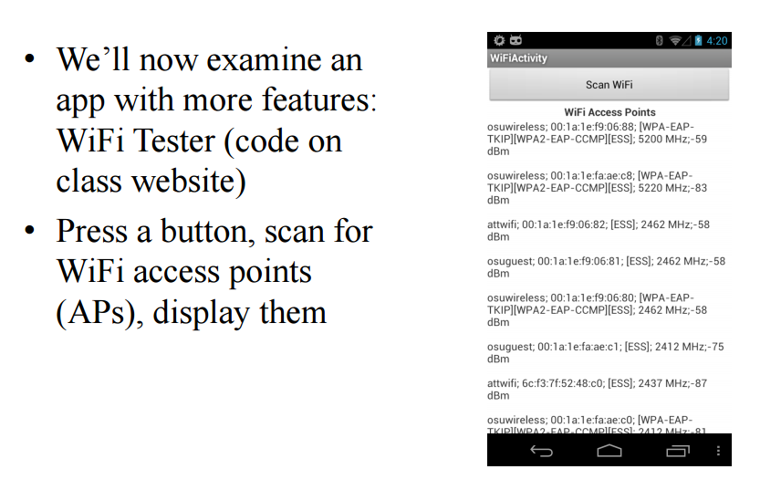
A More Interesting App

Slide 19
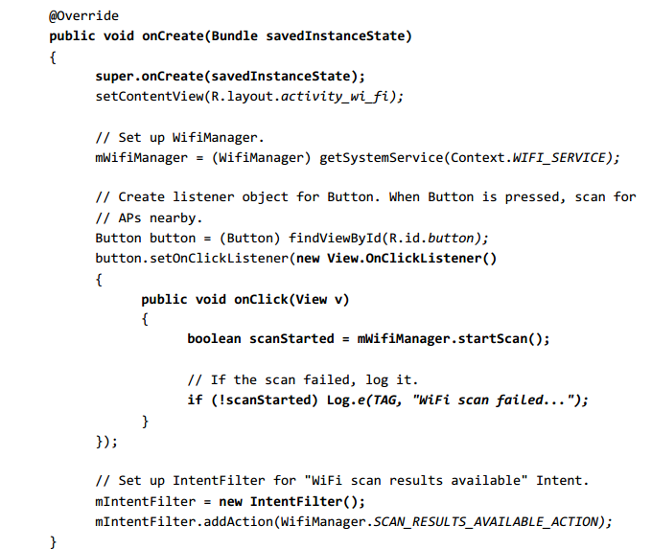
Underlying Source Code (1)

Slide 20
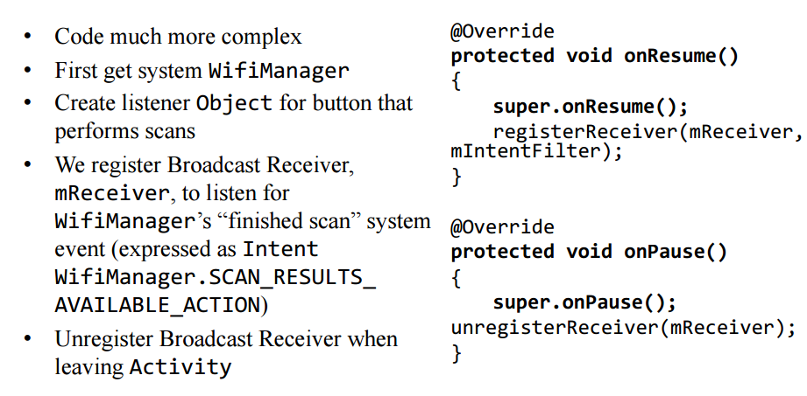
Underlying Source Code (2)

Slide 21
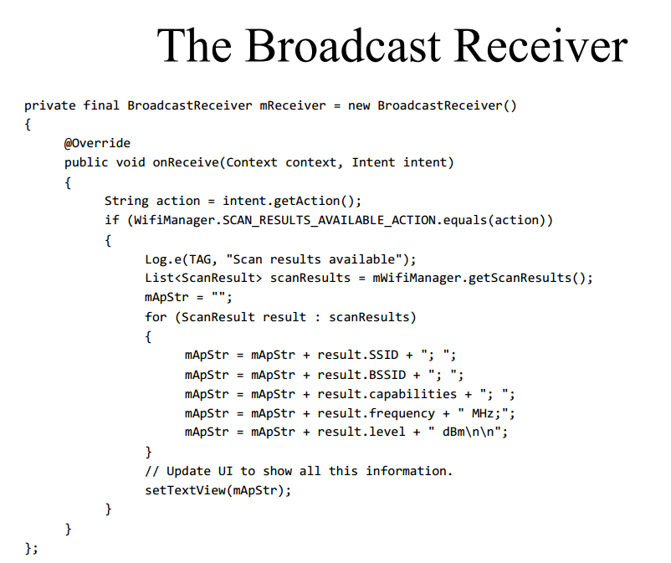

Slide 22
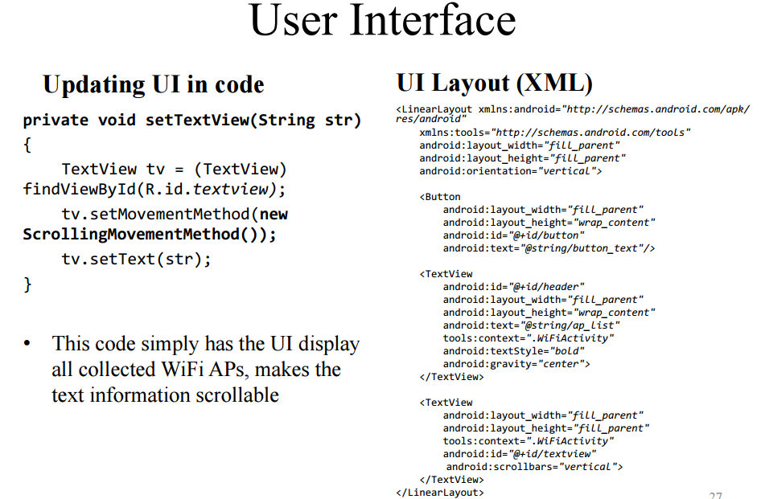

Slide 23
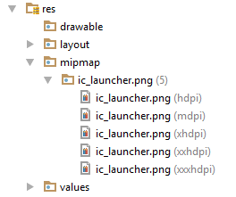
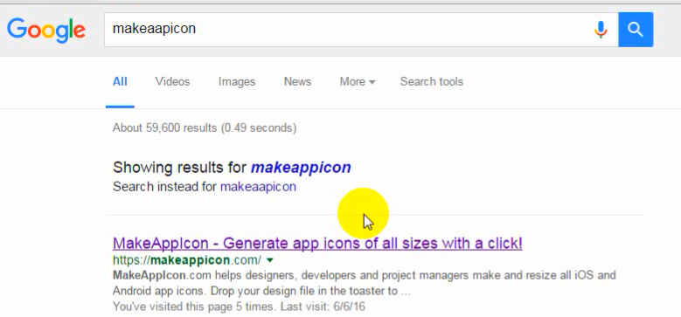
A brief Introduction of Andriod Studio IDE
In res folder -> mipmap folder contain icons having 5 different size. We can make the icon on different size by using online software

Slide 24
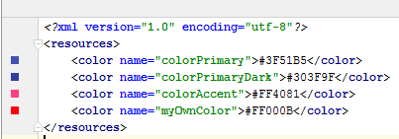
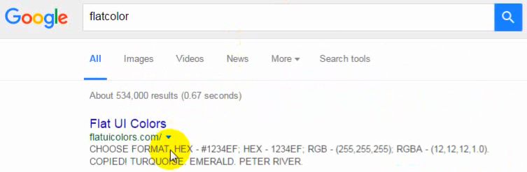
In res folder -> values ->colors.xml
In colors.xml we can define the app or button colors. You can take help by searching like

Slide 25
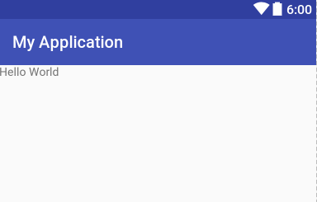
Successful running of Android Studio Looks

Slide 26
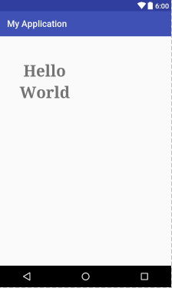
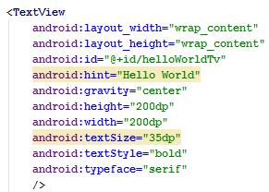
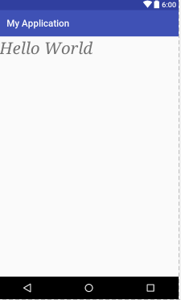
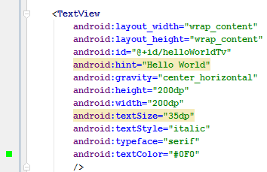
Let’s Apply a few more attributes to the TextView control here:

Slide 27
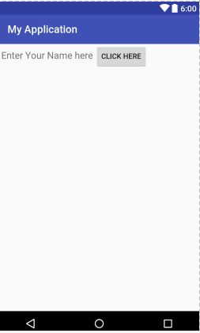
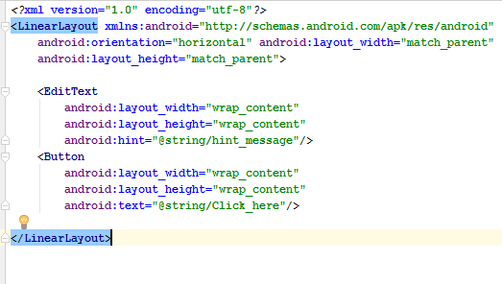
Creating a Simple User Interface

Slide 28
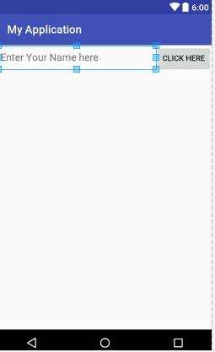
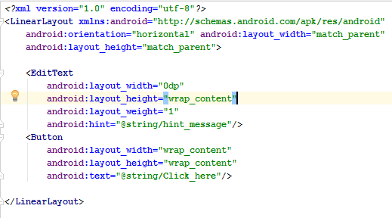
Now after changes

